Slide 1
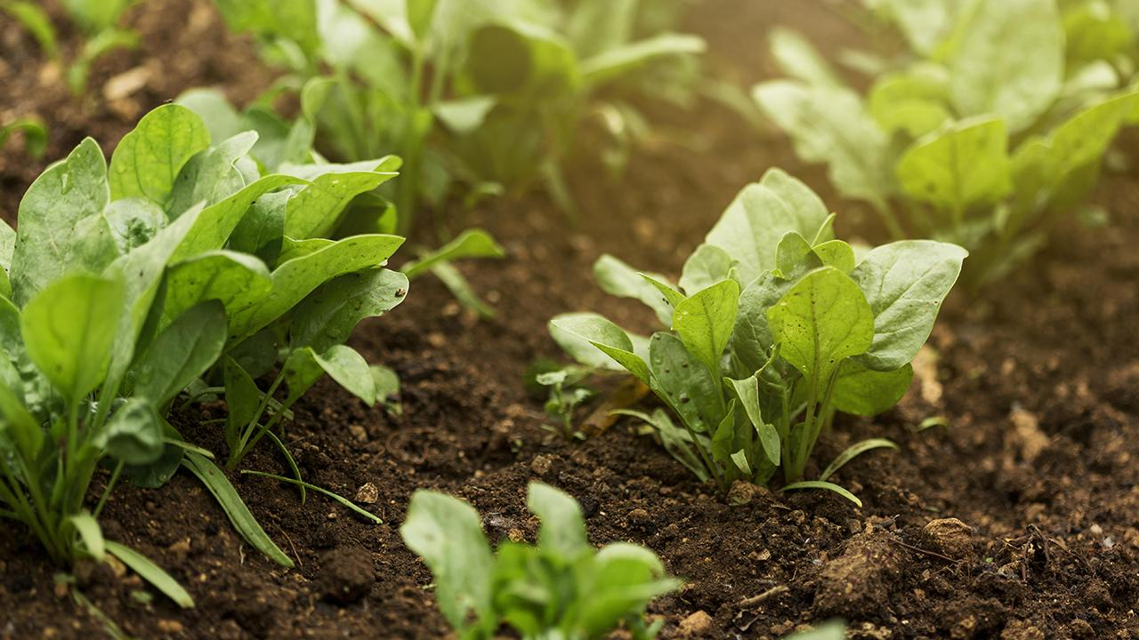

‘Empowering Farmers with Simple Agricultural & Livestock Guidance.’
Human Computer Interaction

Slide 2
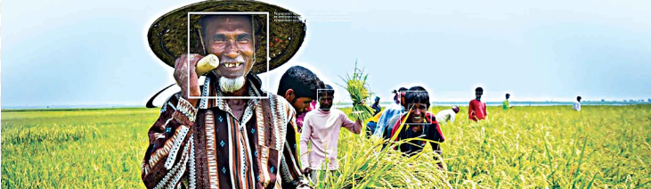
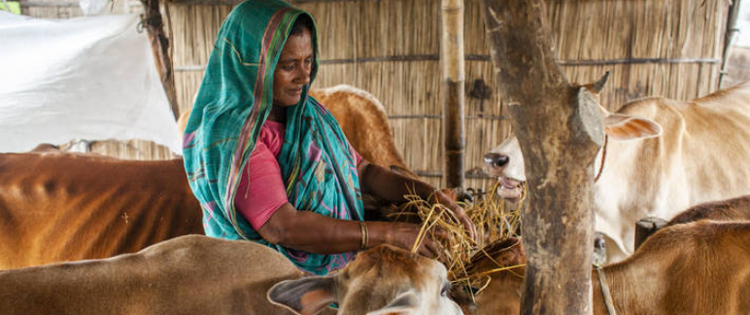
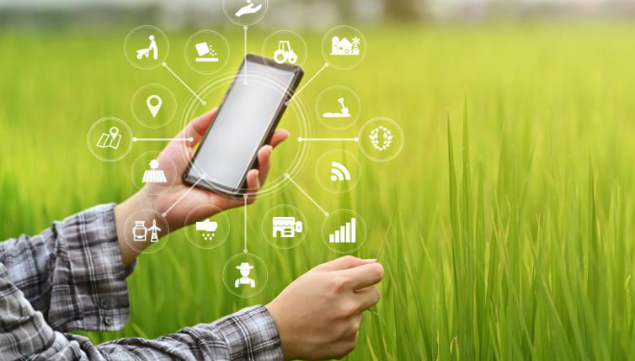
Introduction & Motivation
Farming
Farmers are sometimes unable to learn their farming process easily
Animal Husbandry
In animal husbandry, caring of livestock, and management them should be known
Easily and Simply Know
We want provide information to them easily and simply

Slide 3
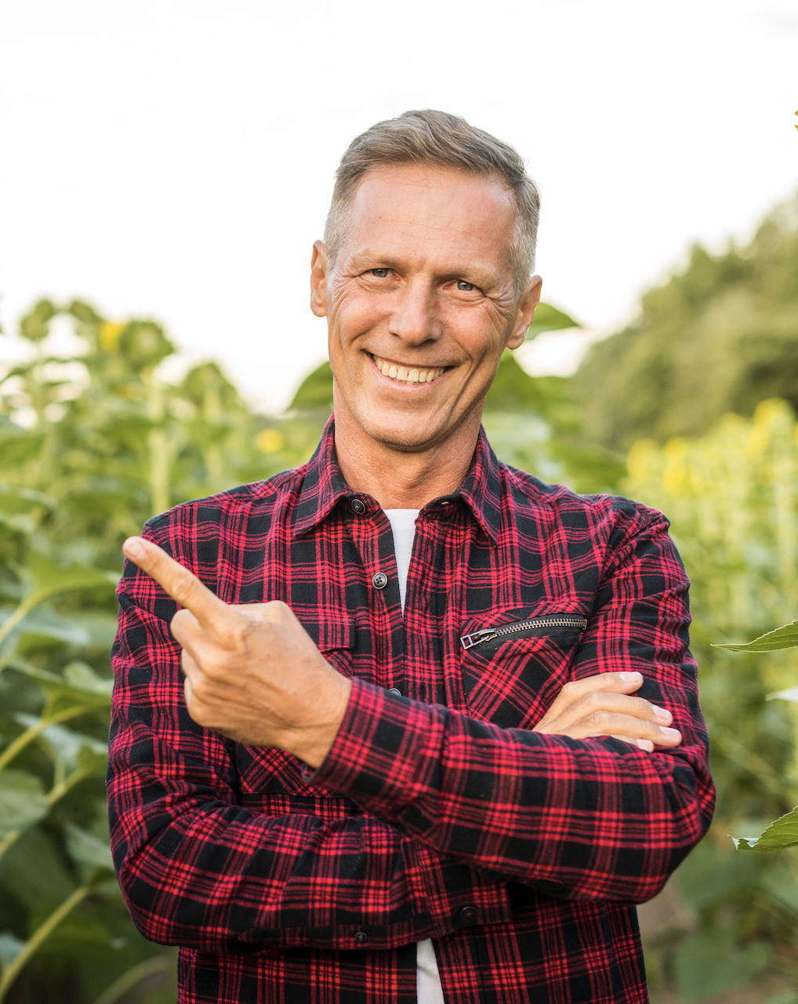
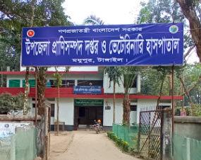

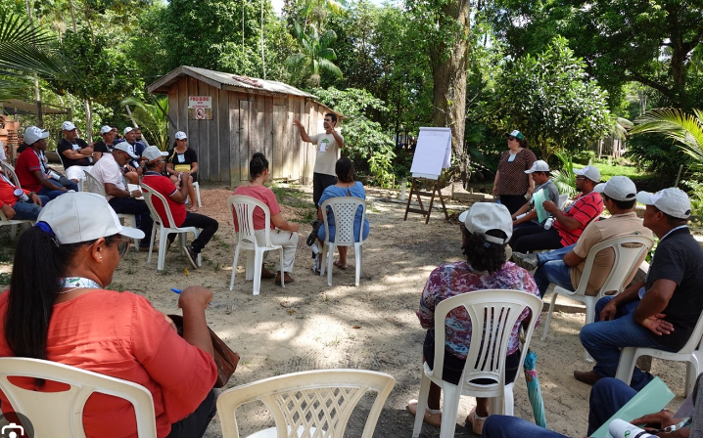

What we did
Identified a major knowledge gap among rural farmers in farming and livestock care. Designed a solution to deliver simple, accessible information tailored to their needs.
Why We Did It:
Many farmers lack formal education or digital literacy.
Empowering them helps food security and rural development.
Limitations of Information Providing Way & new Updates

Slide 4
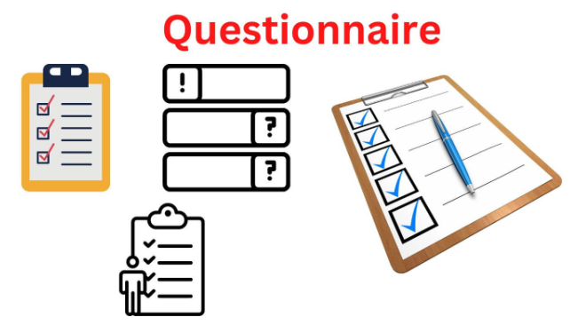
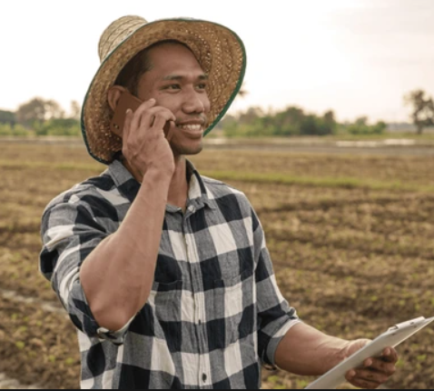
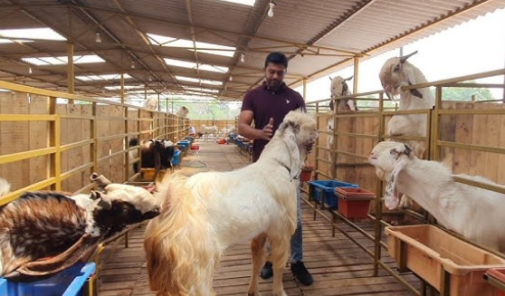
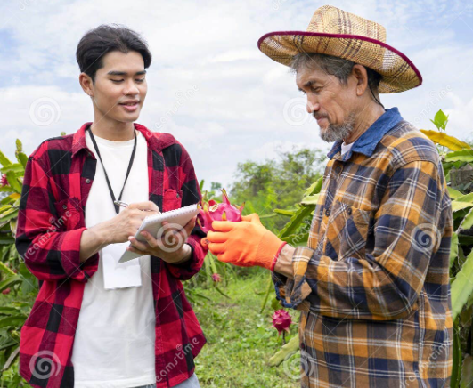

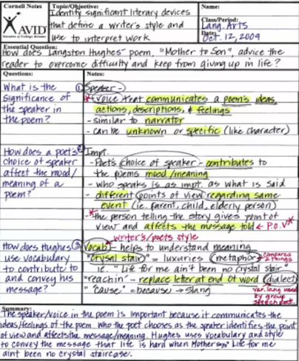
How we did-Research Methods
Questionnaires
Multiple Choice, Open Ended, Selection type
Interview
8 Interview , 4 Agricultural Farmers, 4 Livestock Farmers
Reach out to Them
Phone Calls
Nearby Farm
Collection data
Record Phone calls
Notes

Slide 5
Our goals:
We aim to provide farmers with easy-to-understand, accessible information on farming processes, livestock care, and management techniques.
We 're building an app or platform, consider features like:
🔊 Voice guidance in native language
🎥 Step-by-step video tutorials
📴 Offline access for rural areas
👨‍🌾 Live expert sessions
🗓️ Crop & animal care calendars

